Slide 1
Instruction Set Architecture
Lei Wu
Zhejiang University

Slide 2
Disclaimer
Many images and resources used in this lecture are collected from the Internet, and they are used only for the educational purpose. The copyright belong to the original owners, respectively.
Part of slides credit to
David A. Patterson and John L. Hennessy. Computer Organization and Design RISC-V Edition: The Hardware Software Interface, 1st Edition.
John L. Hennessy and David A. Patterson. Computer Architecture: A Quantitative Approach, 6th Edition.
Andrew Waterman and David A. Patterson. The RISC-V Reader: An Open Architecture Atlas.
CSCE 513, Prof. Yonghong Yan @ University of North Carolina at Charlotte
CENG3420, Bei Yu @ The Chinese University of Hong Kong
CS 3410, Prof. Hakim Weatherspoon @ Cornell University
CS 162, Prof. Sam Kumar @ UC Berkeley
CSc 453, Prof. Saumya Debray @ University of Arizona

Slide 3
Overview
RISC-V ISA
RISC-V Assembly Language

Slide 4
Overview
RISC-V ISA
RISC-V Assembly Language

Slide 5

What is RISC-V?
RISC-V (pronounced "risk-five”) is an ISA standard
An open-source implementation of a reduced instruction set computing (RISC) based instruction set architecture (ISA)
There was RISC-I, II, III, IV before
Most ISAs: X86, ARM, Power, MIPS, SPARC
Commercially protected by patents
Preventing practical efforts to reproduce the computer systems.
RISC-V is open
Permitting any person or group to construct compatible computers
Use associated software
Originated in 2010 by researchers at UC Berkeley
Krste Asanović, David Patterson and students
ISA Specifications
Unprivileged specification version 20191213 (v2.2)
Privileged specification version 20211203 (v1.11)
More on github: https://github.com/riscv/riscv-isa-manual
https://riscv.org/
Notes:
操作数和地址码

Slide 6
Goals in Defining RISC-V
A completely open ISA that is freely available to academia and industry
A real ISA suitable for direct native hardware implementation, not just simulation nor binary translation
An ISA that avoids “over-architecting” for
A particular microarchitecture style (e.g., microcoded, in-order, decoupled, out-of-order) or
Implementation technology (e.g., full-custom, ASIC, FPGA), but which allows efficient implementation in any of these
RISC-V ISA includes
A small base integer ISA, usable by itself as a base for customized accelerators or for educational purposes, and
Optional standard extensions, to support general-purpose software development
Optional customer extensions
Support for the revised 2008 IEEE-754 floating-point standard
Notes:
The goal for RISC-V (“RISC five”) is to become a universal instruction set architecture (ISA): • It should suit all sizes of processors, from the tiniest embedded controller to the fastest high-performance computer. • It should work well with a wide variety of popular software stacks and programming languages. • It should accommodate all implementation technologies: Field-Programmable Gate Arrays (FPGAs), Application-Specific Integrated Circuits (ASICs), full-custom chips, and even future device technologies. • It should be efficient for all microarchitecture styles: microcoded or hardwired control; in-order, decoupled, or out-of-order pipelines; single or superscalar instruction issue; and so on. • It should support extensive specialization to act as a base for customized accelerators, which rise in importance as Moore’s Law fades. • It should be stable, in that the base ISA should not change. More importantly, the ISA cannot be discontinued, as has happened in the past to proprietary ISAs such as the AMD Am29000, the Digital Alpha, the Digital VAX, the Hewlett Packard PA-RISC, the Intel i860, the Intel i960, the Motorola 88000, and the Zilog Z8000.

Slide 7
RISC-V Principles
Generally kept very simple and extendable
Whether short, long, or variable
Separated into multiple specifications
User-level ISA spec (compute instructions)
Compressed ISA spec (16-bit instructions)
Privileged ISA spec (supervisor-mode instructions)
More…
ISA support is given by RV + word-width + extensions supported
E.g., RV32I means 32-bit RISC-V with support for the I (integer) instruction set

Slide 8
User-Level ISA
Defines the normal instructions needed for computation
A mandatory base integer ISA
I: Integer instructions:
ALU
Branches/jumps
Loads/stores
Standard extensions
M: Integer Multiplication and Division
A: Atomic Instructions
F: Single-Precision Floating-Point
D: Double-Precision Floating-Point
C: Compressed Instructions (16 bit)
G = IMAFD: integer base + four standard extensions
Optional extensions

Slide 9
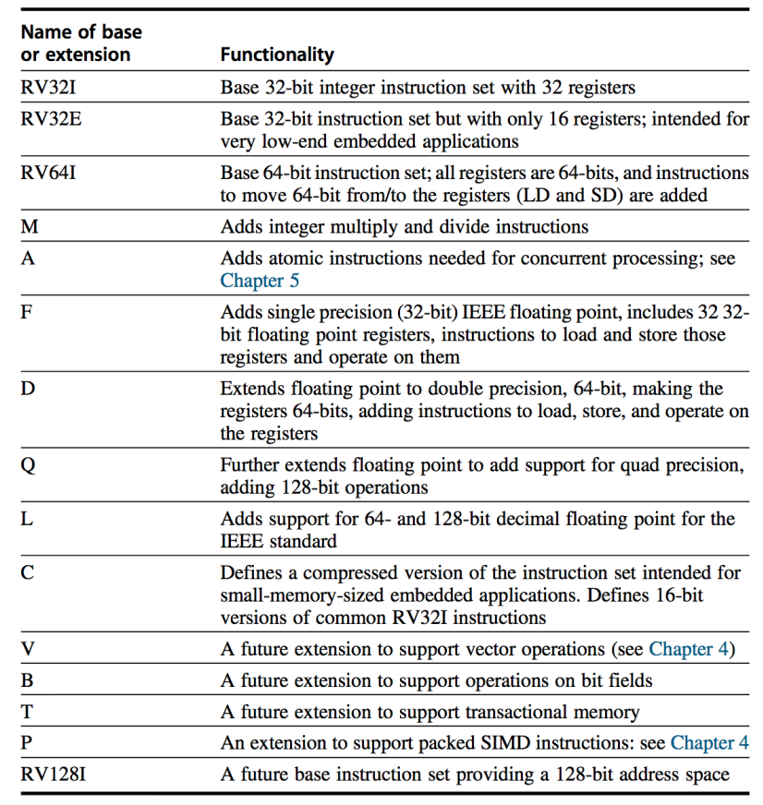
Basic RISC-V ISA
Both 32-bit and 64-bit address space variants
RV32 and RV64
Easy to subset/extend for education/research
RV32IM, RV32IMA, RV32IMAFD, RV32G
SPEC on the website
www.riscv.org

Slide 10
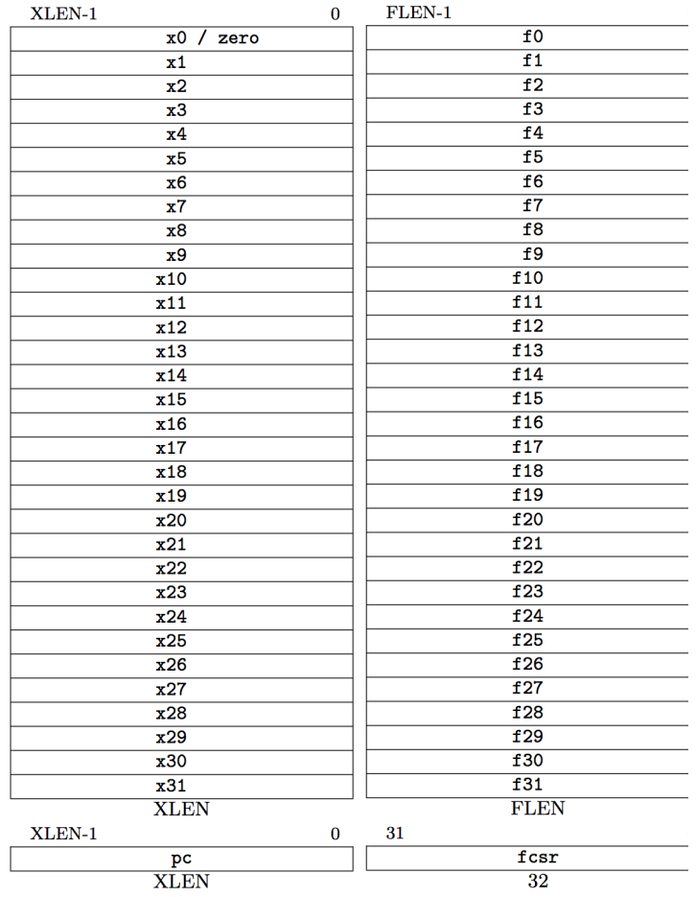
RISC-V Processor State
Program counter (PC)
32 32/64-bit integer registers (x0-x31)
x0 always contains a 0
x1 to hold the return address on a call.
32 floating-point (FP) registers (f0-f31)
Each can contain a single- or double-precision FP value (32-bit or 64-bit IEEE FP)
FP status register (fsr), used for FP rounding mode & exception reporting

Slide 11
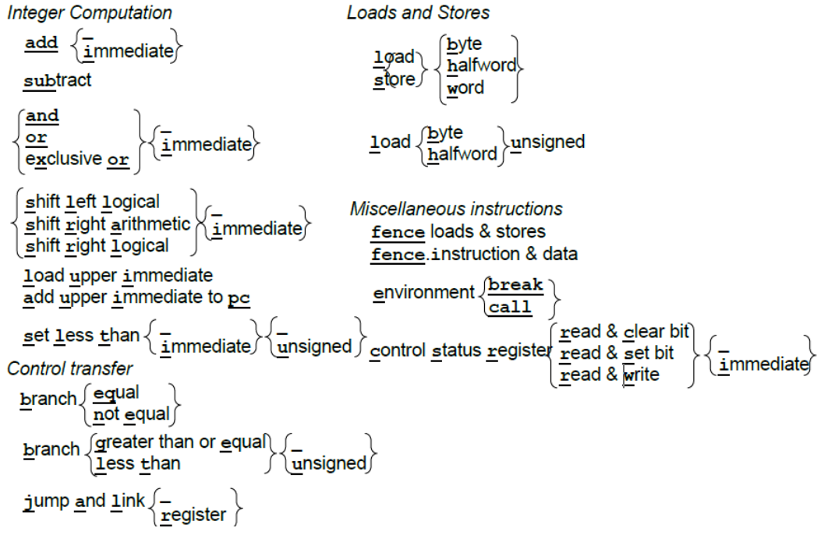
RV32I

Slide 12
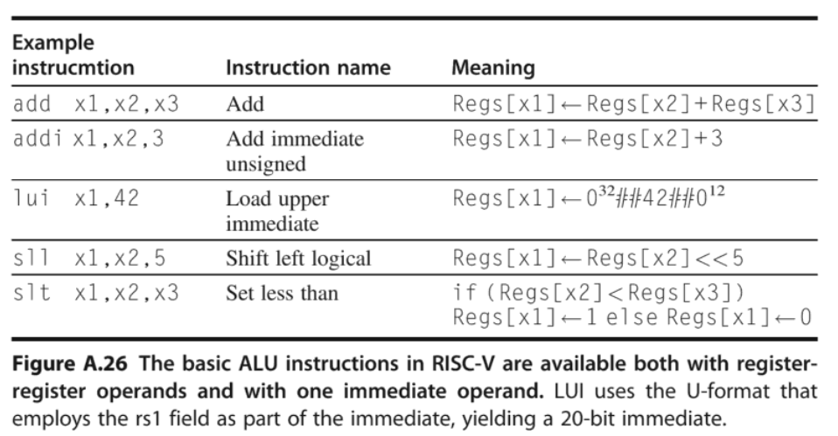
ALU Instructions

Slide 13
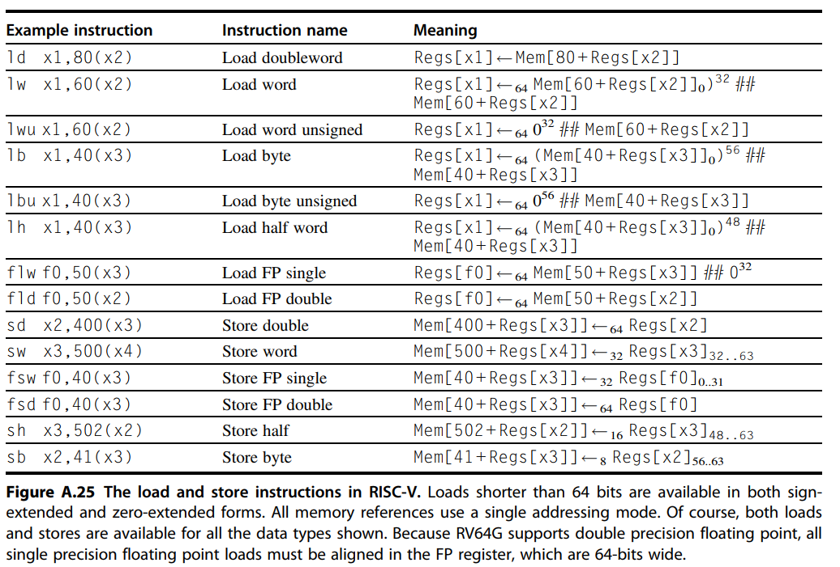
Load/Store Instructions

Slide 14
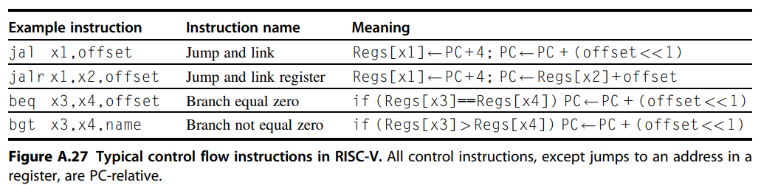
Control Transfer Instructions

Slide 15
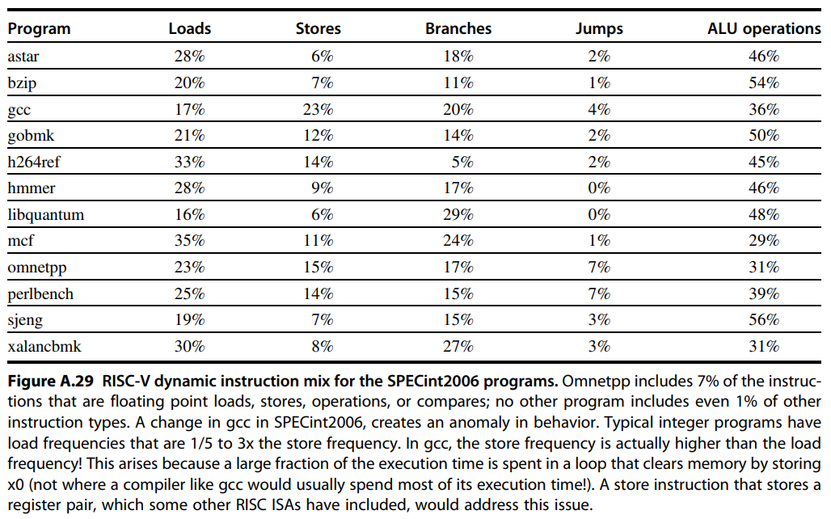
RISC-V Dynamic Instruction Mix for SPECint2006

Slide 16
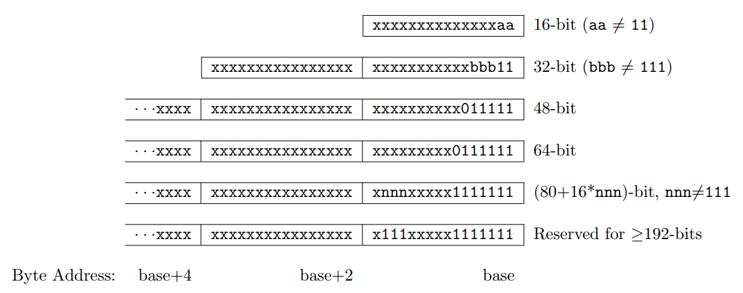
RISC-V Hybrid Instruction Encoding
16, 32, 48, 64, … bits length encoding
Base instruction set (RV32) always has fixed 32-bit instructions with lowest two bits = 11₂
All branches and jumps have targets at 16-bit granularity (even in base ISA where all instructions are fixed 32 bits)
Notes:
The base RISC-V ISA has fixed-length 32-bit instructions that must be naturally aligned on 32-bit boundaries. However, the standard RISC-V encoding scheme is designed to support ISA extensions with variable-length instructions, where each instruction can be any number of 16-bit instruction parcels in length and parcels are naturally aligned on 16-bit boundaries. The standard compressed ISA extension described in Chapter 16 reduces code size by providing compressed 16-bit instructions and relaxes the alignment constraints to allow all instructions (16 bit and 32 bit) to be aligned on any 16-bit boundary to improve code density.
We use the term IALIGN (measured in bits) to refer to the instruction-address alignment constraint the implementation enforces. IALIGN is 32 bits in the base ISA, but some ISA extensions, including the compressed ISA extension, relax IALIGN to 16 bits. IALIGN may not take on any value other than 16 or 32. We use the term ILEN (measured in bits) to refer to the maximum instruction length supported by an implementation, and which is always a multiple of IALIGN. For implementations supporting only a base instruction set, ILEN is 32 bits. Implementations supporting longer instructions have larger values of ILEN.
Only the 16-bit and 32-bit encodings are considered frozen at this time.

Slide 17
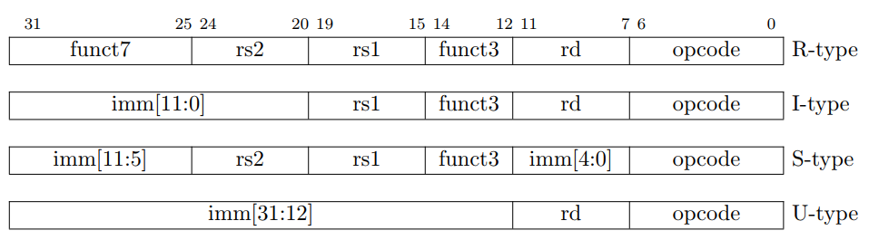
Four Core RISC-V Instruction Formats
https://github.com/riscv/riscv-opcodes/
Additional opcode bits/immediate
Additional opcode bits
7-bit opcode field
(but low 2 bits = 112)
Reg. Source 2
Reg. Source 1
Destination Reg.
Aligned on a four-byte boundary in memory. There are variants!
Sign bit of immediates always on bit 31 of instruction. Register fields never move.

Slide 18
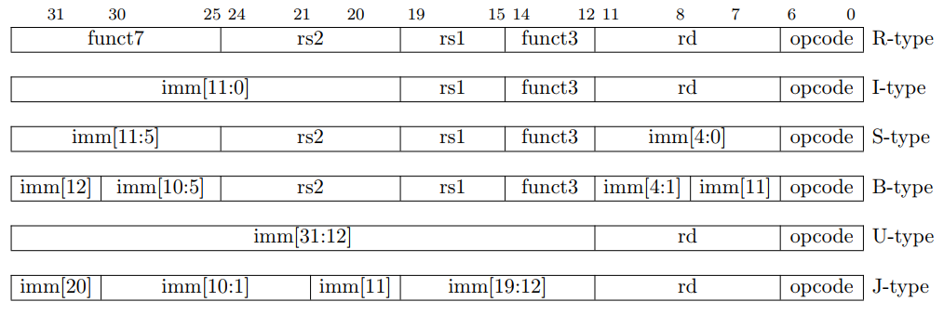
Immediate Encoding Variants
S-type vs. B-type
The 12-bit immediate field is used to encode branch offsets in multiples of 2 in the B format. Instead of shifting all bits in the instruction-encoded immediate left by one in hardware as is conventionally done, the middle bits (imm[10:1]) and sign bit stay in fixed positions, while the lowest bit in S format (inst[7]) encodes a high-order bit in B format.
U-type vs. J-type
Similarly, the 20-bit immediate is shifted left by 12 bits to form U immediates and by 1 bit to form J immediates. The location of instruction bits in the U and J format immediates is chosen to maximize overlap with the other formats and with each other.
Notes:
用于寄存器-寄存器操作的 R 类型指令
用于短立即数和访存 load 操作的 I 型指令
用于访存 store 操作的 S 型指令
用于条件跳转操 作的 B 类型指令
用于长立即数的 U 型指令
用于无条件跳转的 J 型指令

Slide 19
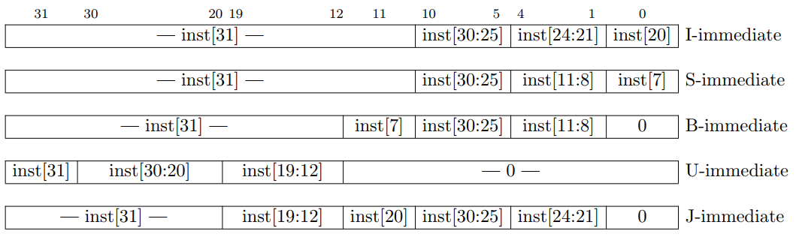
Immediate Encoding Variants
Notes:
Types of immediate produced by RISC-V instructions. The fields are labeled with the instruction bits used to construct their value. Sign extension always uses inst[31]

Slide 20
RISC-V Encoding Summary
Name | Field |  |  |  |  |  | Comments
Field size | 7 bits | 5 bits | 5 bits | 3 bits | 5 bits | 7 bits
R-type | funct7 | rs2 | rs1 | funct3 | rd | opcode | Arithmetic instruction format
I-type | imm[11:0] |  | rs1 | funct3 | rd | opcode | Loads & immediate arithmetic
S-type | imm[11:5] | rs2 | rs1 | funct3 | imm[4:0] | opcode | Stores
B-type | imm[12,10:5] | rs2 | rs1 | funct3 | imm[4:1,11] | opcode | Conditional branch format
J-type | imm[20,10:1,11,19:12] |  |  |  | rd | opcode | Unconditional jump format
U-type | imm[31:12] |  |  |  | rd | opcode | Upper immediate format
Notes:
用于寄存器-寄存器操作的 R 类型指令
用于短立即数和访存 load 操作的 I 型指令
用于访存 store 操作的 S 型指令
用于条件跳转操 作的 B 类型指令
用于长立即数的 U 型指令
用于无条件跳转的 J 型指令

Slide 21
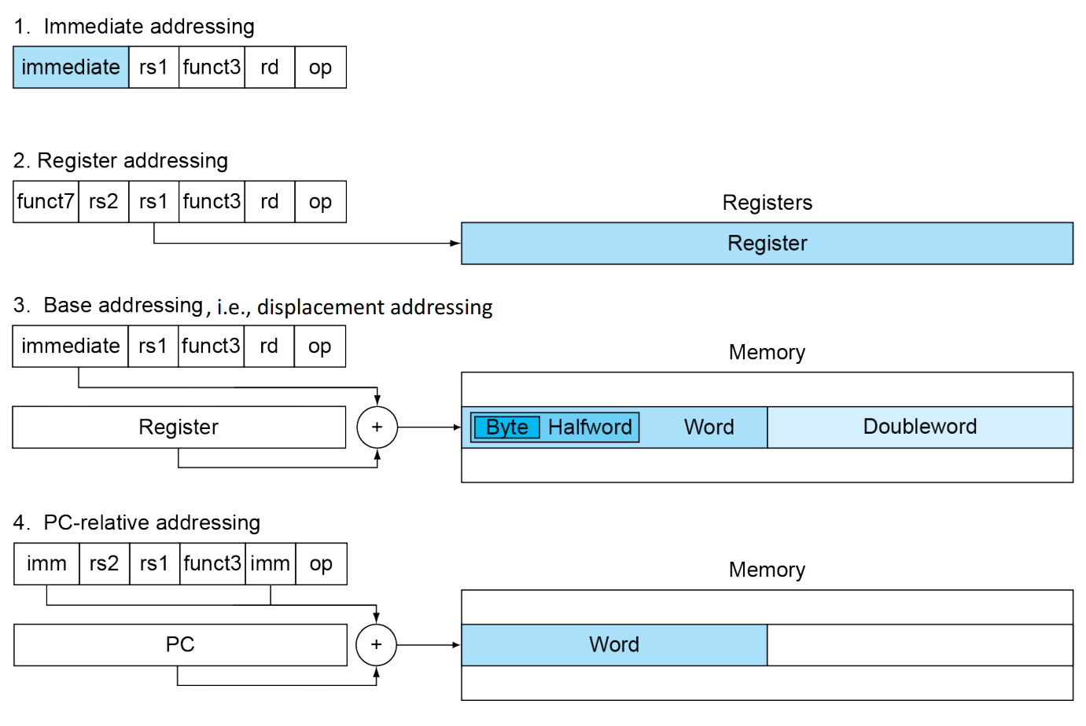
RISC-V Addressing Modes
Notes:
1. Immediate addressing, where the operand is a constant within the instruction itself.
2. Register addressing, where the operand is a register.
3. Base or displacement addressing, where the operand is at the memory location whose address is the sum of a register and a
constant in the instruction.
4. PC-relative addressing, where the branch address is the sum of the PC and a constant in the instruction.
Note that a single operation can use more than one addressing mode. Add, for example, uses both immediate (addi) and register (add) addressing.

Slide 22
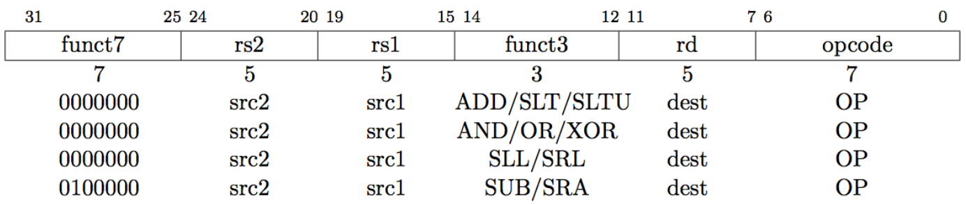
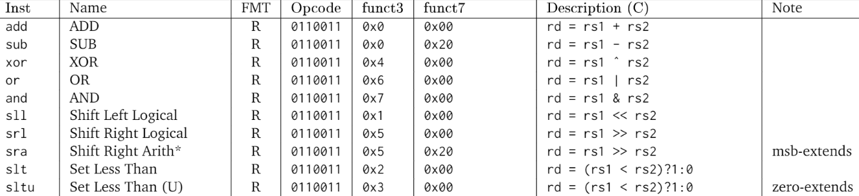
ALU Instructions: R-Type
R-type (Register)
rs1 and rs2 are the source register, rd is the destination
ADD/SUB
SLT, SLTU: set less than
SRL, SLL, SRA: shift logic or arithmetic left or right

Slide 23
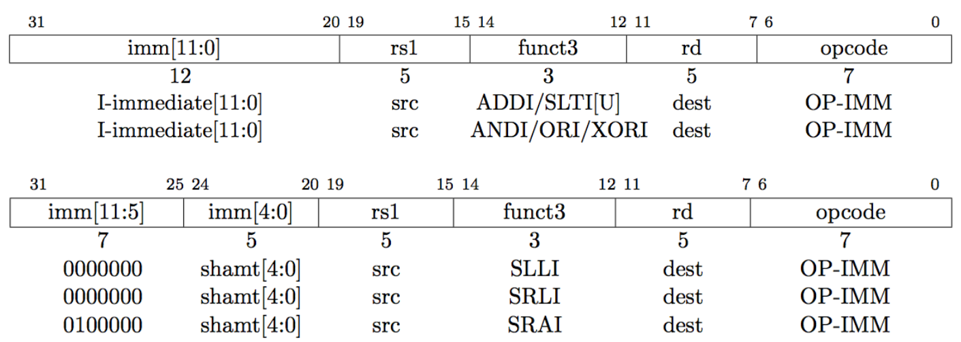
ALU Instructions: I-Type
I-type (immediate), all immediates in all instructions are sign extended
ADDI: adds sign extended 12-bit immediate to rs1
SLTI(U): set less than immediate
ANDI/ORI/XORI: logical operations
SLLI/SRLI/SRAI: shifts by constants
I-type instructions end with I
Notes:
No SUB here.
Immediate arithmetic and load instructions
rs1: source or base address register number
immediate: constant operand, or offset added to base address
2’s-complement, sign extended
Design principle: good design demands good compromises
Different formats complicate decoding, but allow 32-bit instructions uniformly
Keep formats as similar as possible
shamt: shift amount

Slide 24
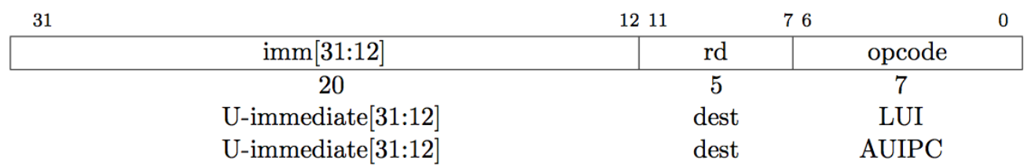
ALU Instructions: U-Type
LUI/AUIPC: load upper immediate/add upper immediate to PC
Writes 20-bit immediate to top of destination register
Used to build large immediates
12-bit immediates are signed, so have to account for sign when building 32-bit immediates in 2-instruction sequence (LUI high-20 bits, ADDI low-12 bits)
Notes:
lui rd,imm[31:12]
addi rd,rd,imm[11:0]
Here lui places a (sign-extended) 20-bit immediate into register rd and fills the lowest 12 bits with zeros, and addi adds a sign-extended 12-bit immediate to register rd.
https://kqueue.org/blog/2020/08/22/shifting-range/

Slide 25
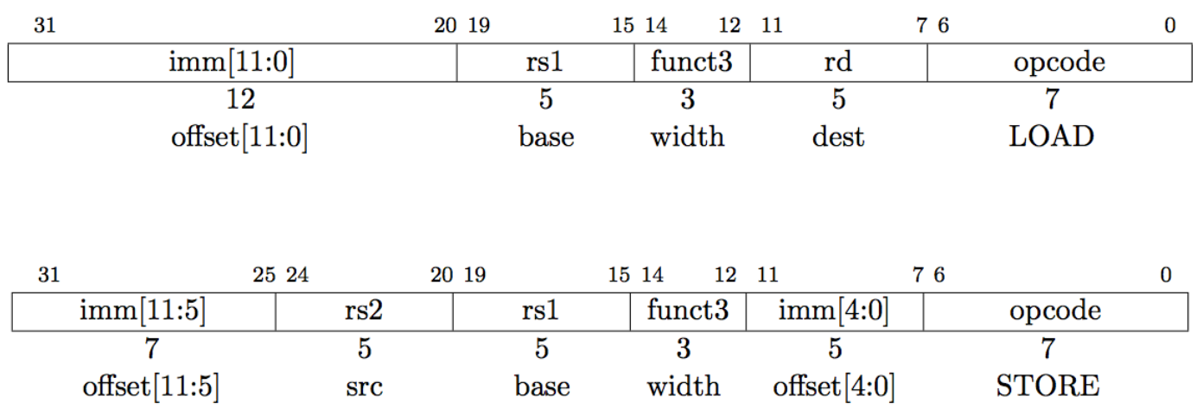
Load/Store Instructions: I/S-Type
Load instruction (I-type)
rd = MEM (rs1 + imm)
Store instruction (S-type)
MEM (rs1 + imm) = rs2
Notes:
Different immediate format for store instructions
rs1: base address register number
rs2: source operand register number
immediate: offset added to base address
Split so that rs1 and rs2 fields always in the same place

Slide 26
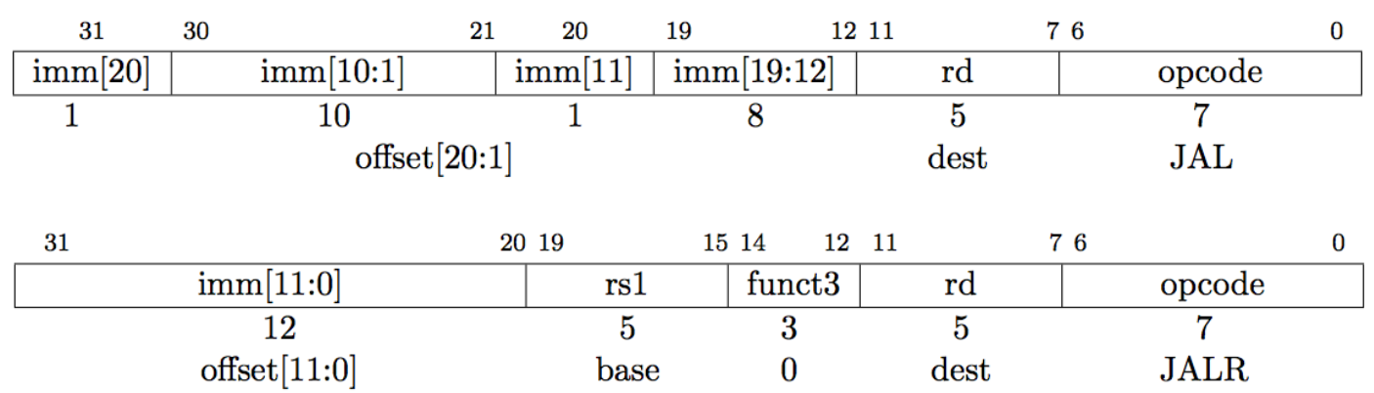
Control Transfer Instructions: J-Type
No architecturally visible delay slots
Unconditional jumps: PC + offset target
JAL: jump and link, also writes PC + 4 to x1, J-type
Offset scaled by 1-bit left shift – can jump to 16-bit instruction boundary (same for branches)
JLAR: jump and link register where imm (12bits) + rd1 = target

Slide 27
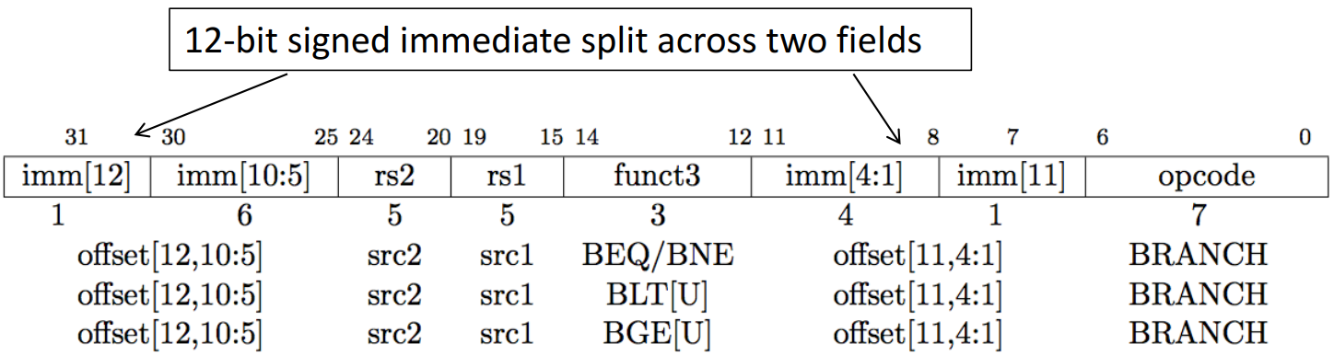
Control Transfer Instructions: B-Type
No architecturally visible delay slots
Conditional branches: B-type and PC + offset target
Branches, compare two registers, PC + (immediate << 1) target (signed offset in multiples of two). Branches do not have delay slot.

Slide 28
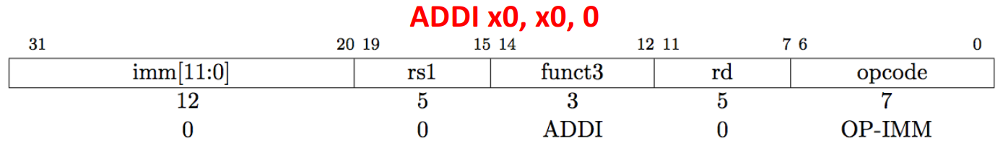
Where is NOP?

Slide 29
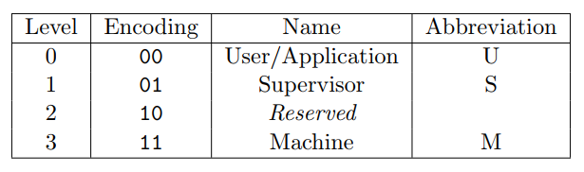
Privileged ISA: Modes
RISC-V privileged spec defines 3 levels of privilege, called modes
Machine mode is the highest privileged mode and the only required mode
More-privileged modes generally have access to all of the features of less-privileged modes, and they add additional functionality not available to less-privileged modes, such as the ability to handle interrupts and perform I/O. Processors typically spend most of their execution time in their least-privileged mode; interrupts and exceptions transfer control to more-privileged modes.

Slide 30
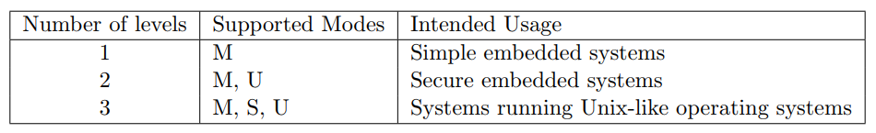
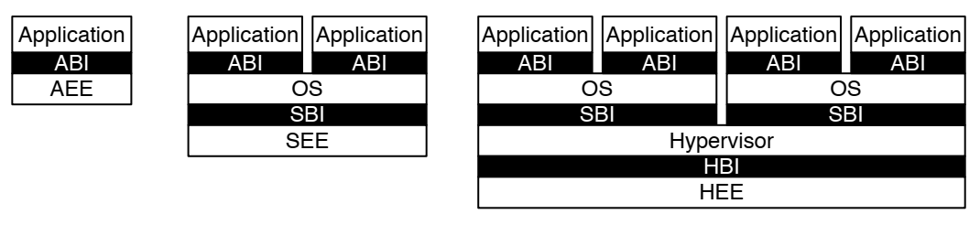
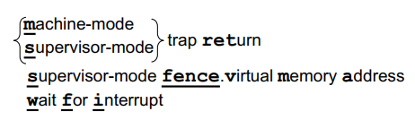
Software Stack and Instructions
Implementations might provide anywhere from 1 to 4 privilege modes trading off reduced isolation for lower implementation cost
RISC-V privileged software stack
RV32/64 privileged instructions
Notes:
AEE: Application Execution Environment; ABI: Application Binary Interface
SEE: Supervisor Execution Environment; …
HEE: Hypervisor Execution Environment; …

Slide 31
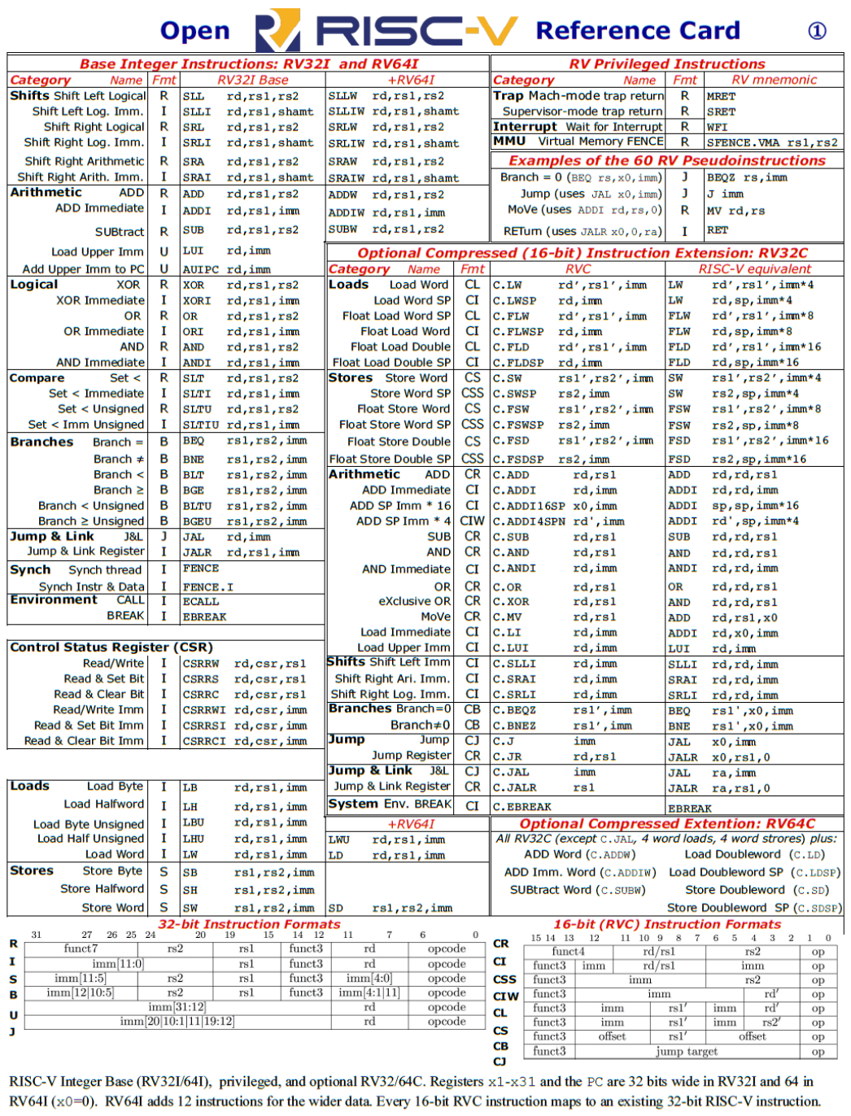
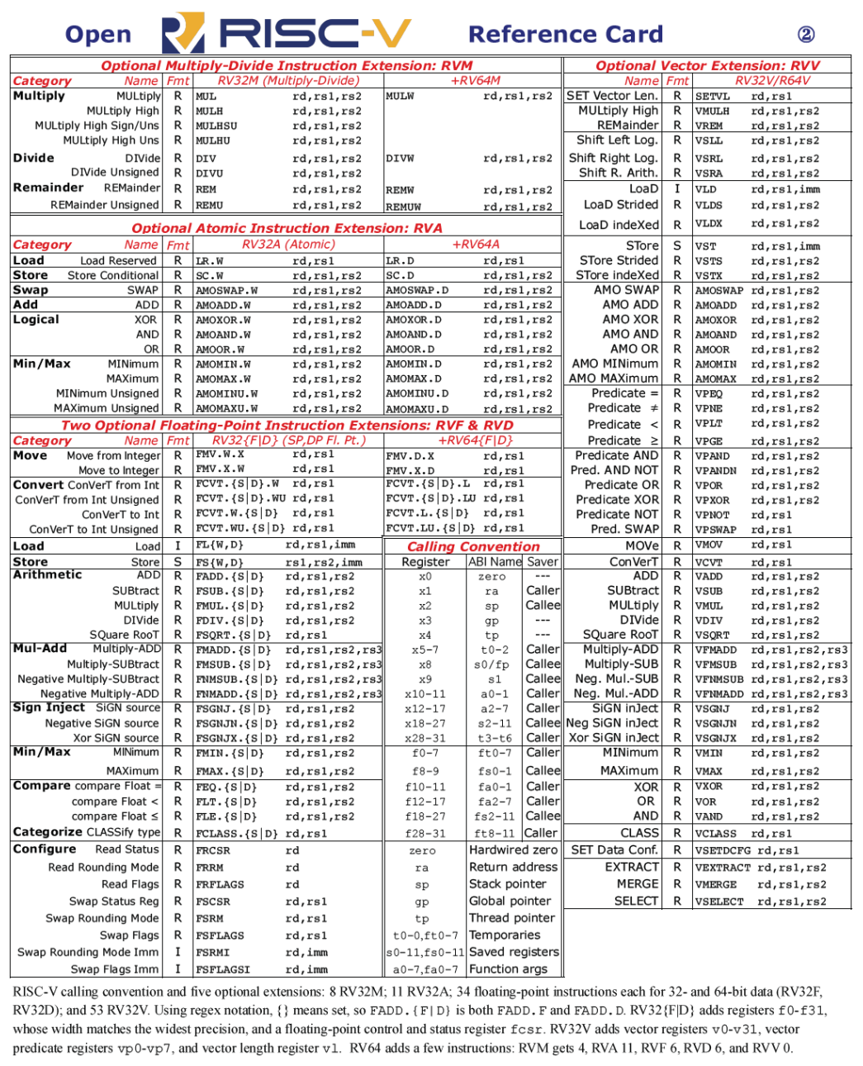
RISC-V Reference Card

Slide 32
Specifications and Software
Specification from RISC-V website
https://riscv.org/specifications/
RISC-V software includes
Toolchain projects
https://wiki.riscv.org/display/HOME/Toolchain+Projects
A simulator (“spike”)
https://github.com/riscv-software-src/riscv-isa-sim
Standard simulator QEMU (Upstream now)
https://github.com/riscv/riscv-qemu
Operating systems support exists for Linux (Upstream now)
https://github.com/riscv/riscv-linux
A javascript ISA simulator to run a RISC-V Linux system on a web browser
https://github.com/riscv/riscv-angel
Notes:
Basically, spike is the best simulator for hardware developers. qemu is the best simulator for software developers. The gdb sim is maybe best if you are familiar with other gdb sims, and want access to features that gdb sims support.

Slide 33
Overview
RISC-V ISA
RISC-V Assembly Language
Some basic concepts
From source code to a running program

Slide 34
Overview
RISC-V ISA
RISC-V Assembly Language
Some basic concepts
From source code to a running program

Slide 35
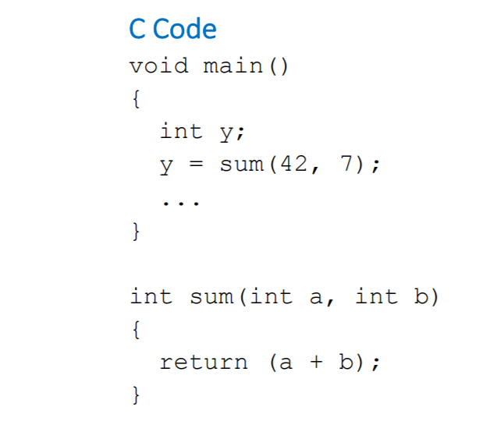
Function calls
Caller: calling function
main in this case
Callee: called function
sum in this case

Slide 36
Function calls
Caller: calling function
main in this case
Passes arguments to callee
Jumps to callee
Callee: called function
sum in this case
Performs the function
Returns result to caller
Returns to point of call
Notes:
Must not overwrite registers or memory needed by caller

Slide 37
Calling Convention
Six general stages in calling a function
Place the arguments where the function can access them.
Jump to the function (using RV32I’s jal).
Acquire local storage resources the function needs, saving registers as required.
Perform the desired task of the function.
Place the function result value where the calling program can access it, restore any registers, and release any local storage resources.
Since a function can be called from several points in a program, return control to the point of origin (using ret).
Notes:
1. 将参数存储到函数能够访问到的位置； 2. 跳转到函数开始位置（使用 RV32I 的 jal 指令）； 3. 获取函数需要的局部存储资源，按需保存寄存器； 4. 执行函数中的指令； 5. 将返回值存储到调用者能够访问到的位置，恢复寄存器，释放局部存储资源； 6. 返回调用函数的位置（使用 ret 指令 ）。

Slide 38
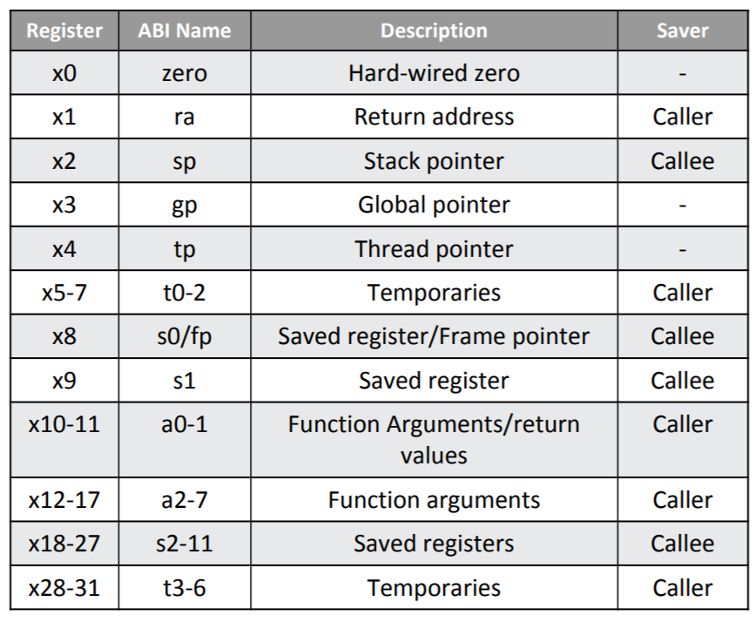
Registers
We can manipulate 32 GPRs in assembly programming directly
Sometimes ABI names (aliases) are preferred
Notes:
To obtain good performance, try to keep variables in registers rather than memory, but on the other hand, avoid going to memory frequently to save and restore these registers. Keep operands in registers yet reduce the need to save and restore them.
The insight is to have some registers that are not guaranteed to be preserved across a function call, called temporary registers, and some that are, called saved registers.
Functions that avoid calling other functions are called leaf functions. When a leaf function has only a few arguments and local variables, we can keep everything in registers without “spilling” any to memory. If these conditions don’t hold, then the program must save register values in memory, but a surprising fraction of function calls fall into this happy case.
The saved and temporary registers aren’t contiguous: to support RV32E, an embedded version of RISC-V that has only 16 registers. It simply uses register numbers x0 to x15, so some saved and temporary registers are in this range, and the rest are in the last 16 registers. RV32E is smaller, but has no compiler support yet, since it doesn’t match RV32I.
Call Function: jump and link (jal) • Return from function: jump register (jr ra)

Slide 39
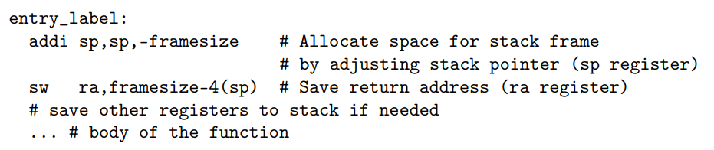
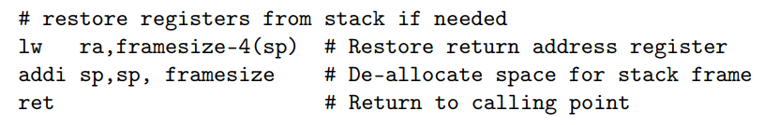
Function Entry and Exit
The function prologue
If there are too many function arguments and variables to fit in the registers, the prologue allocates space on the stack for the function frame, as it is called.
The function epilogue
Undoes the stack frame and returns to the point of origin.

Slide 40

The Stack
Memory used to temporarily save variables
Like stack of dishes, last-in-first-out (LIFO) queue
Expands: uses more memory when more space needed
Contracts: uses less memory when the space is no longer needed

Slide 41
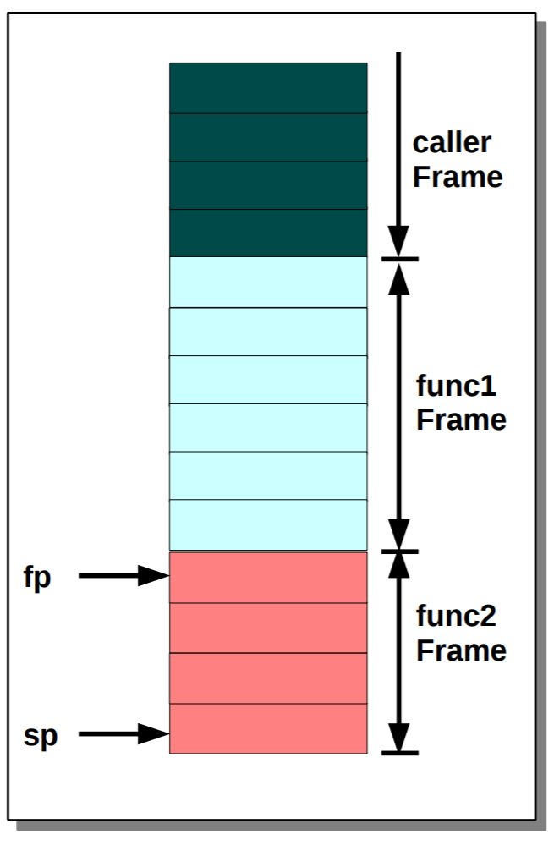
Stack Frame
Private space for a subroutine allocated on entry and deallocated on exit
Identified by a Frame Pointer (fp (x8))

Slide 42
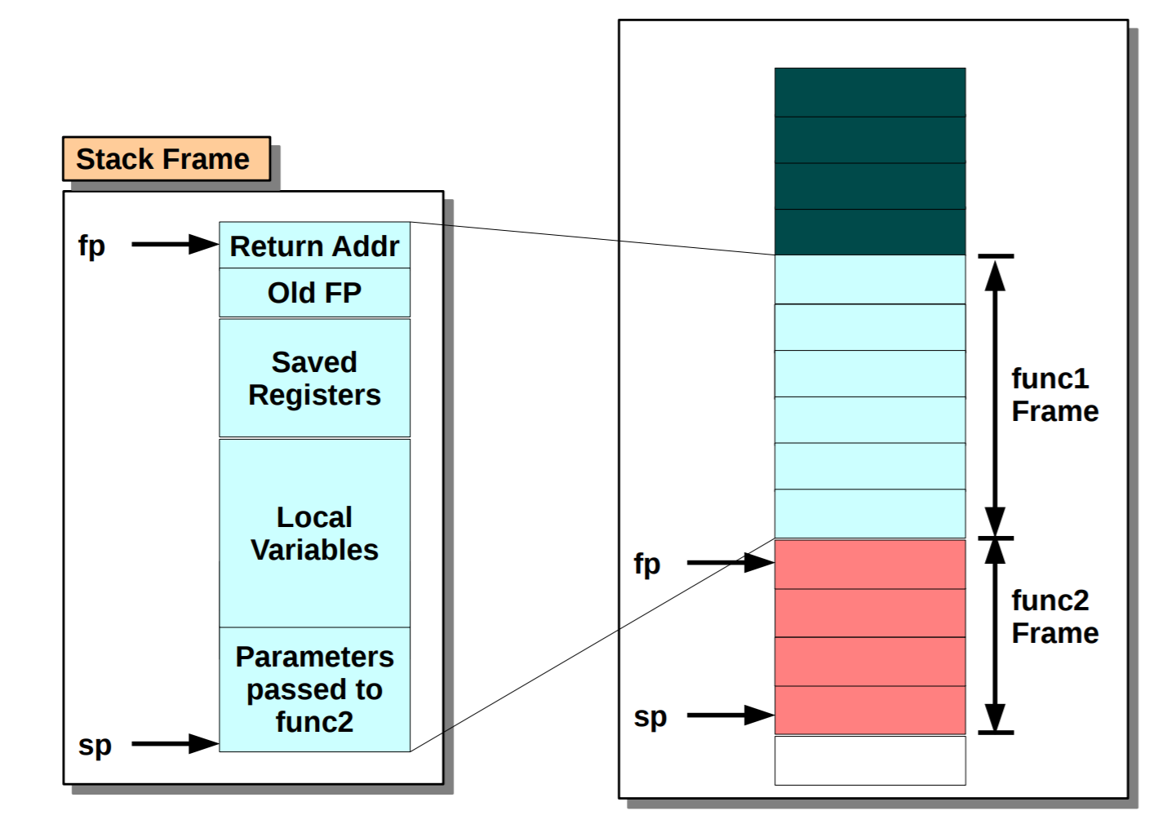
Stack Frame

Slide 43
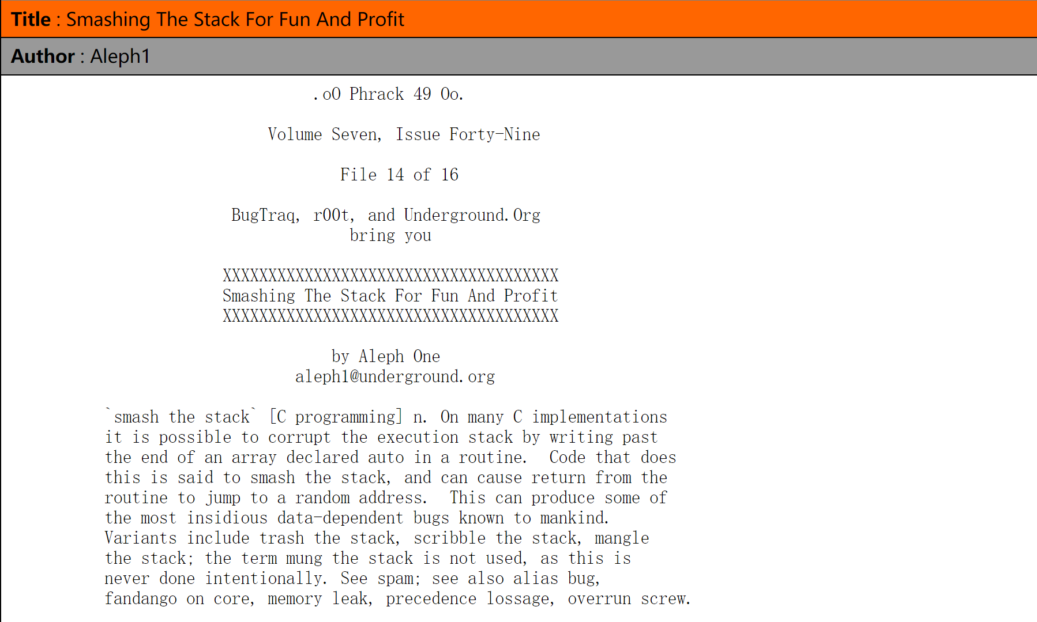
Stack Overflow
Smashing The Stack For Fun And Profit
http://phrack.org/issues/49/14.html

Slide 44
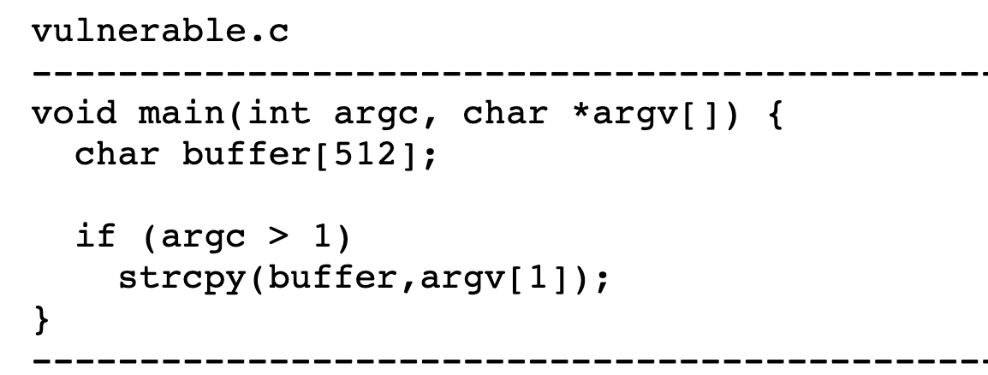
How To Smash the Stack?

Slide 45
Overview
RISC-V ISA
RISC-V Assembly Language
Some basic concepts
From source code to a running program

Slide 46
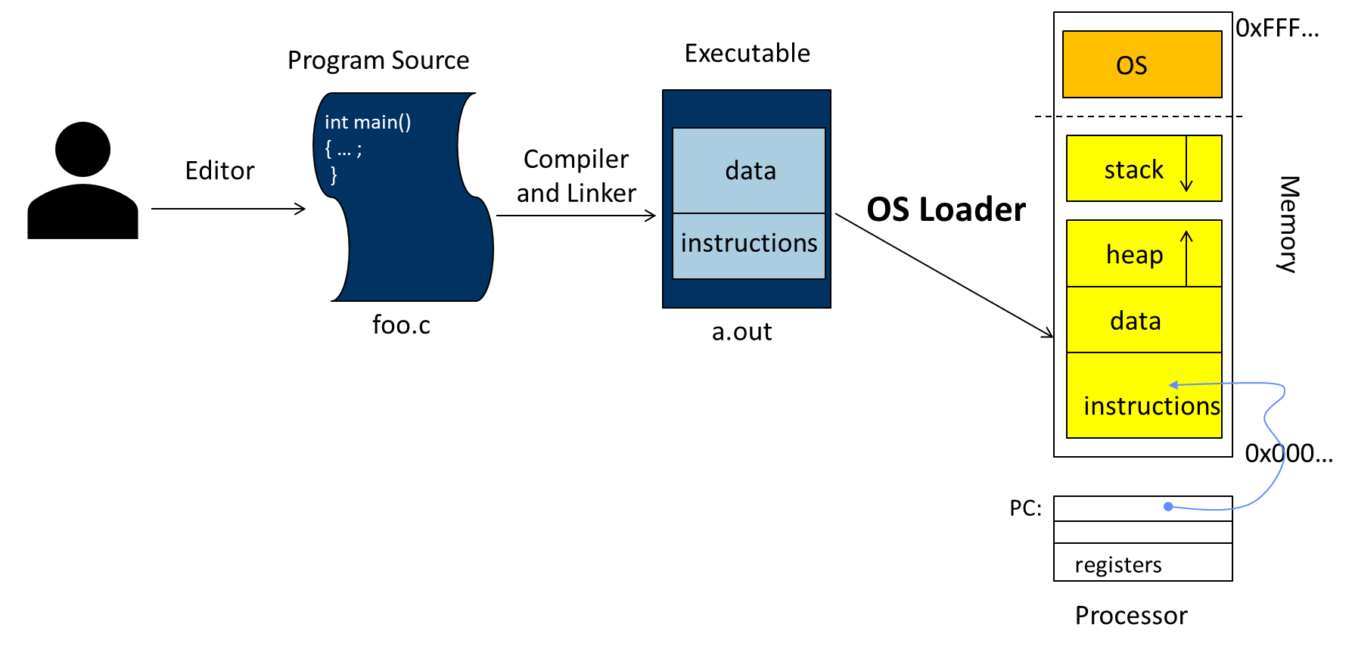
From Source Code to A Running Program
Write source code
Turn the source code into the executable program
Run it!

Slide 47
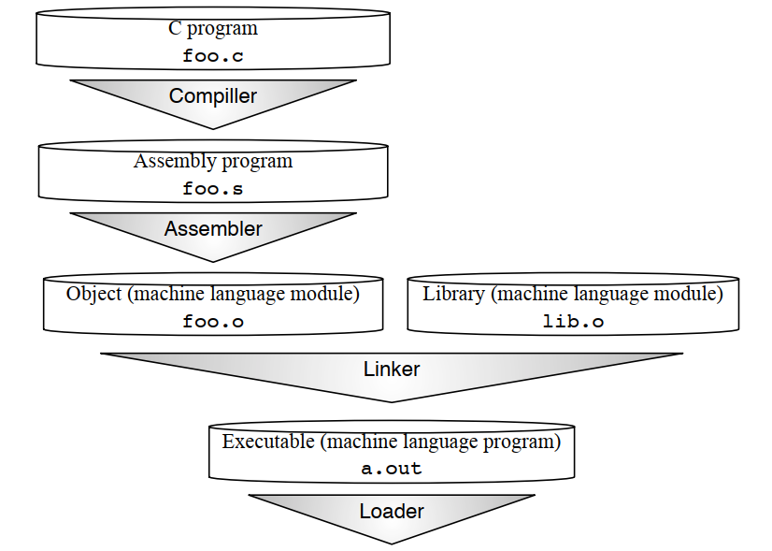
From C Source Code to A Running Program
Steps of translation from C source code to a running program. These are the logical steps, although some steps are combined to accelerate translation.
Notes:
We use the Unix file suffix name convention for each type of file. The equivalent suffixes in MS-DOS are .C, .ASM, .OBJ, .LIB, and .EXE.
1. Compiler output is assembly files
2. Assembler output is obj files
How does the assembler resolve references/labels?
How does the assembler resolve external references?
3. Linker joins object files into one executable
How does the linker combine separately compiled files?
How does linker resolve unresolved references?
How does linker relocate data and code segments
4. Loader brings it into memory and starts execution
How does the loader start executing a program?
How does the loader handle shared libraries?

Slide 48
Compiler: *.c -> *.s
Steps of translation from C source code to a running program. These are the logical steps, although some steps are combined to accelerate translation.

Slide 49
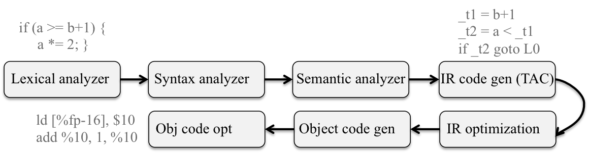
Compiler
Preprocessor (*.c -> *i)
Expands all macro definitions and include statements (and anything else starting with a #) and passes the result to the actual compiler.
Compiler (*.i -> *.s)
https://people.cs.pitt.edu/~xianeizhang/notes/Linking.html

Slide 50
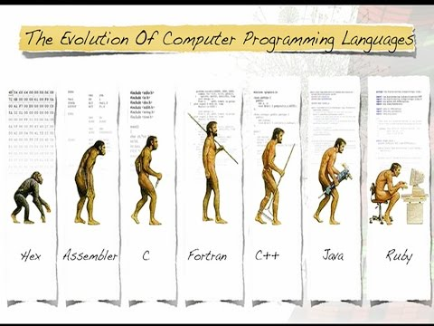
Evolution of Programming Languages

Slide 51

Bootstraping: Self-Compiling Compilers
A compiler (or assembler) written in the source programming language that it intends to compile.
An initial core version of the compiler (the bootstrap compiler) is generated in a different language (which could be assembly language); successive expanded versions of the compiler are developed using this minimal subset of the language.
The problem of compiling a self-compiling compiler has been called the chicken-or-egg problem in compiler design, and bootstrapping is a solution to this problem

Slide 52
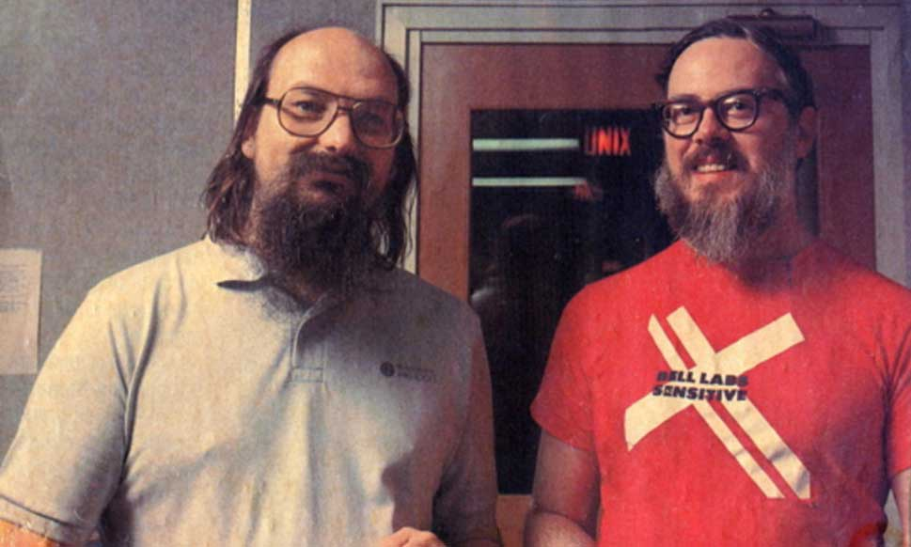
Reflections on Trusting Trust

Slide 53
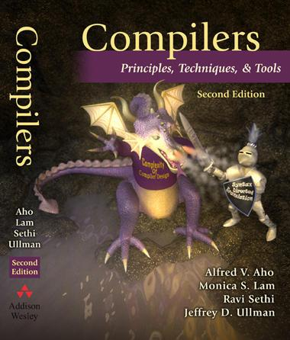

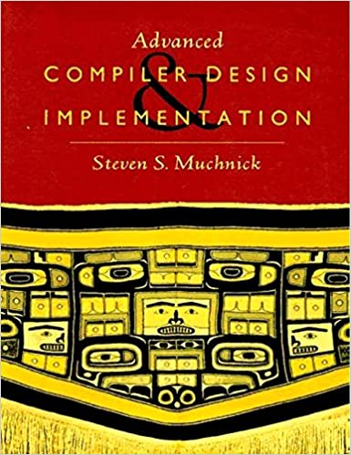
NOT Be Detailed in This Class…
Because You Deserve More!

Slide 54
Assembler: *.s -> *.o
Steps of translation from C source code to a running program. These are the logical steps, although some steps are combined to accelerate translation.
Notes:
We use the Unix file suffix name convention for each type of file. The equivalent suffixes in MS-DOS are .C, .ASM, .OBJ, .LIB, and .EXE.

Slide 55
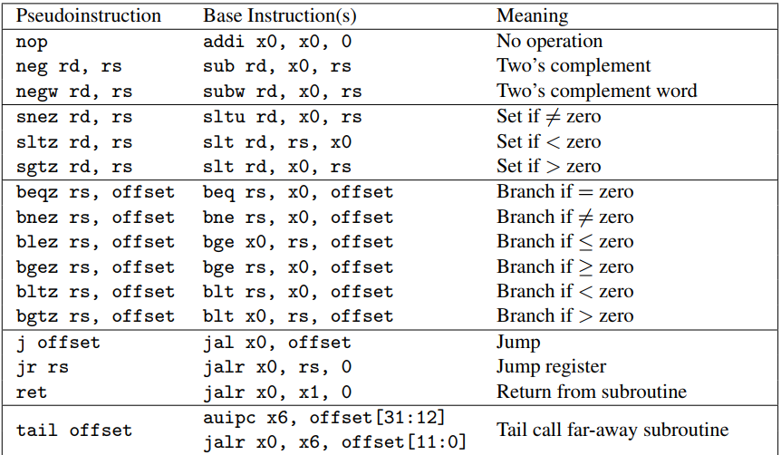
Assembler
Not simply to produce object code from the instructions that the processor understands, but to extend them to include operations useful for the assembly language programmer or the compiler writer. This category, based on clever configurations of regular instructions, is called pseudo-instructions.
Notes:
32 RISC-V pseudo-instructions that rely on x0

Slide 56
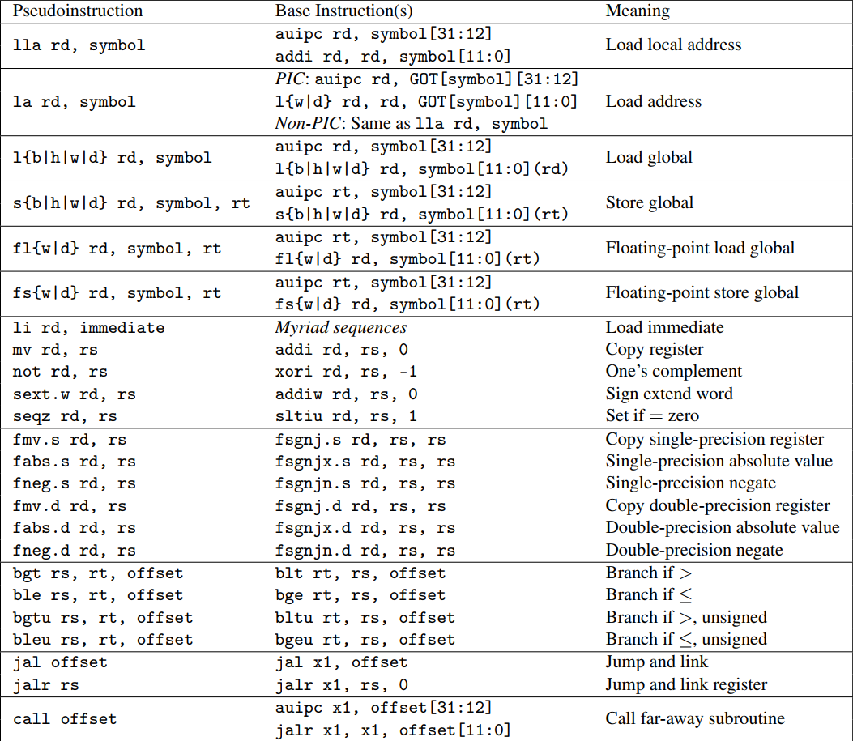
Assembler
Notes:
32 RISC-V pseudo-instructions that are independent of x0, the zero register.
For la, GOT stands for Global Offset Table, which holds the runtime address of symbols in dynamically linked libraries.

Slide 57
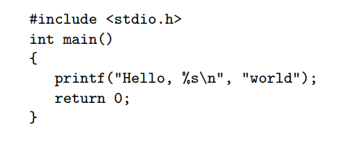
“Hello World” in C

Slide 58
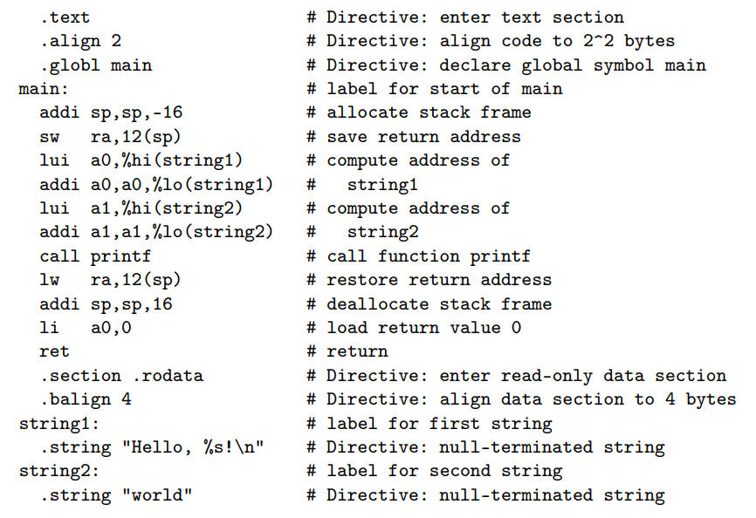
Input: in Assembly Language (*.s)

Slide 59
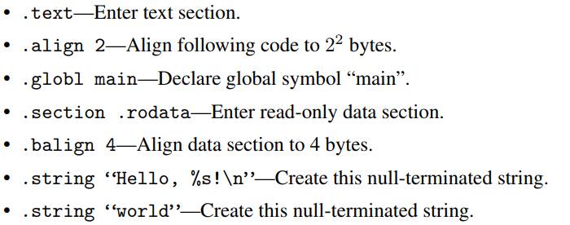
Assembler Directives

Slide 60
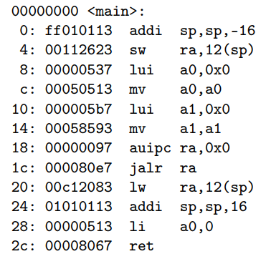
Output: in RISC-V Machine Language (*.o)
The assembler produces the object using the Executable and Linkable Format (ELF, formerly named Extensible Linking Format) standard format.
Notes:
The six instructions that are later patched by the linker (locations 8 to 1c) have zero in their address fields.
The symbol table included in the object file records the labels and addresses of all the instructions that need to be edited by the linker.

Slide 61
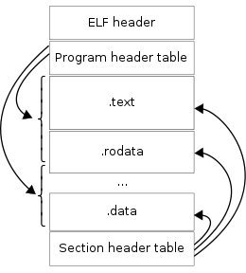
Executable and Linkable Format (ELF)
ELF is a common standard file format for executable files, object code, shared libraries, and core dumps.
The standard binary file format for Unix and Unix-like systems on x86 processors by the 86open project.
By design, the ELF format is flexible, extensible, and cross-platform. This has allowed it to be adopted by many different operating systems on many different hardware platforms.
An ELF file has two views: the program header shows the segments used at run time, whereas the section header lists the set of sections.
Notes:
ELF, formerly named Extensible Linking Format
Each ELF file is made up of one ELF header, followed by file data. The data can include:
Program header table, describing zero or more memory segments
Section header table, describing zero or more sections
Data referred to by entries in the program header table or section header table

Slide 62
ELF Object Files
Created by the assembler and the linker, object files are binary representations of programs intended to be executed directly on a processor.
Programs that require other abstract machines, such as shell scripts, are excluded.
There are three main types of object files:
A relocatable file holds code and data suitable for linking with other object files to create an executable or a shared object file.
An executable file holds a program suitable for execution; the file specifies how exec creates a program's process image.
A shared object file holds code and data suitable for linking in two contexts. First, the linker processes the shared object file with other relocatable and shared object files to create another object file. Second, the dynamic linker combines it with an executable file and other shared objects to create a process image.
Notes:
Relocatable File 可重定位文件未链接之前的ELF文件，可用于链接可执行文件或静态链接库Linux下的".o"文件，Windows下".obj"文件
Executable File 可执行文件最终的可执行程序如Linux下"/bin"目录下文件，Windows的".exe"文件
Shared Objected File 共享目标文件一种是可用于静态链接文件，另一种是程序运行中被动态链接文件如Linux下的".a"和".so"文件，Windows的dll文件
Core Dump File 核心转储文件进程意外终止时，保存进程地址空间的内容以及其他信息Linux下的core dump

Slide 63
Relocatable vs. Executable
ELF Header
ELF Header
Program-Header Table
(optional)
Program-Header Table
Section 1 Data
Segment 1 Data
Section 2 Data
Segment 2 Data
Section 3 Data
Segment 3 Data
…
Section n Data
…
Segment n Data
Section-Header Table
Section-Header Table
(optional)
Relocatable File
Executable File
Notes:
Object files participate in program linking (building a program) and program execution (running a program). For convenience and efficiency, the object file format provides parallel views of a file's contents, reflecting the differing needs of those activities. An ELF header resides at the beginning and holds a ``road map'' describing the file's organization. Sections hold the bulk of object file information for the linking view: instructions, data, symbol table, relocation information, and so on.
A program header table tells the system how to create a process image. Files used to build a process image (execute a program) must have a program header table; relocatable files do not need one.
A section header table contains information describing the file's sections.
Every section has an entry in the table; each entry gives information such as the section name, the section size, and so on. Files used during linking must have a section header table; other object files may or may not have one.

Slide 64
Relocatable Object File
As assembler’s output
Binary machine code, but NOT executable
E.g., .o for Linux, while .obj for Windows
May refer to external symbols
Need a symbol table
Each object file has its own address space
Addresses will need to be fixed later

Slide 65
Symbols and References
Global labels: Externally visible “exported” symbols
Can be referenced from other object files
Exported functions, global variables
Local labels: Internal visible only symbols
Only used within this object file
Static functions, static variables, loop labels, …

Slide 66
Issues Need to be Resolved
How does the Assembler resolve local references?
How does the Assembler resolve external references?

Slide 67
How to Resolve Local References?
Handle forward references
Two-pass assembly
Do a pass through the whole program, allocate instructions and lay out data, thus determining addresses
Do a second pass, emitting instructions and data, with the correct label offsets now determined
One-pass (or backpatch) assembly
Do a pass through the whole program, emitting instructions, emit a 0 for jumps to labels not yet determined, keep track of where these instructions are
Backpatch, fill in 0 offsets as labels are defined

Slide 68
Format of Relocatable Object File
Header
Size and position of pieces of file
Text Section
Instructions
Data Section
Static data (local/global vars, strings, constants)
Debugging Information
Line number -> code address map, etc.
Symbol Table
External (exported) references
Unresolved (imported) references

Slide 69
Commonly Used Sections
Text (.section .text)
Contain code (instructions)
Read-Only Data (.section .rodata)
Contains pre-initialized constants
Read-Write Data (.section .data)
Contains pre-initialized variables
BSS (.section .bss)
Contains un-initialized data
http://www.faqs.org/faqs/unix-faq/faq/part1/section-3.html
Useful Tools: Objdump & Readelf

Slide 70
Linker: (multiple) *.o -> a.out
Steps of translation from C source code to a running program. These are the logical steps, although some steps are combined to accelerate translation.
Notes:
在操作系统发展早期，还没有形成链接器的概念，操作系统的加载器(Loader,LD) 完成了类似工作，后面由于系统越来越复杂，也就引入了链接器(Linker)，但是由于习惯问题，LD 还是链接器的代名词。
我们常见的链接文件也是以 ld 为后缀的。

Slide 71
Linker
Rather than compile all the source code every time one file changes, the linker allows individual files to be compiled and assembled separately.
Why separate compile/assemble and linking steps?
Separately compiling modules and linking them together obviates the need to recompile the whole program every time something changes
Need to just recompile a small module
A linker coalesces object files together to create a complete program
The linker “stitches” the new object code together with existing machine language modules, such as libraries.
Notes:
It derives its name from one of its tasks, which is to all edit the links of the jump and link instructions in the object file.
In fact, linker is short for link editor, which was the historical name of this step in Figure.

Slide 72
Role of Linker
ELF Header
ELF Header
Section 1 Data
Section 2 Data
Program-Header Table
…
Section n Data
Segment 1 Data
Section-Header Table
Segment 2 Data
Relocatable File
…
Segment n Data
ELF Header
Section 1 Data
Section 2 Data
…
Section n Data
Executable File
Section-Header Table
Relocatable File

Slide 73
Issues Need to be Resolved
How does the linker combine separately compiled files?
How does linker resolve unresolved references?
How does linker relocate data and code segments
To combine object files into an executable file
Relocate each object’s text and data segments
Resolve as-yet-unresolved symbols
Record top-level entry point in executable file

Slide 74
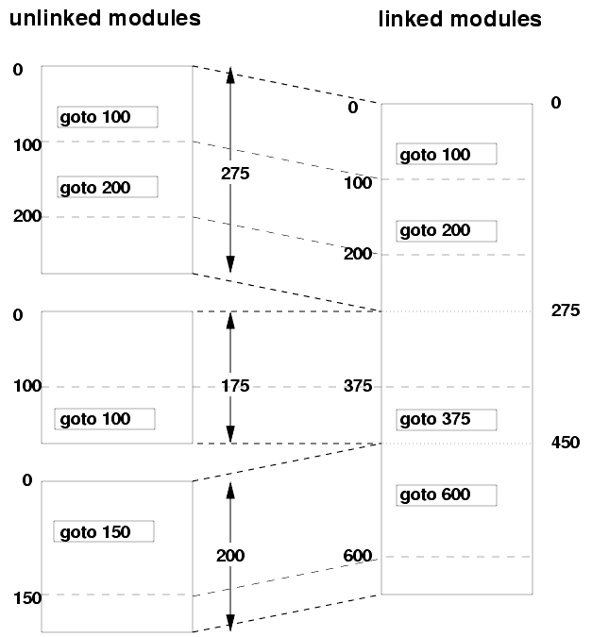
Linker Functions 1: Fixing Addresses
Addresses in an object file are usually relative to the start of the code or data segment in that file.
When different object files are combined:
The same kind of segments (text, data, read-only data, etc.) from the different object files get merged.
Addresses have to be “fixed up” to account for this merging.
The fixing up is done by the linker, using information embedded in the executable for this purpose (“relocations”).

Slide 75
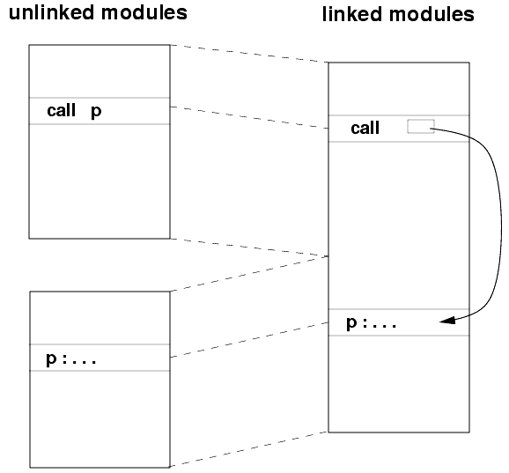
Linker Function 2: Symbol Resolution
Suppose:
Module B defines a symbol x;
Module A refers to x.
The linker must:
Determine the location of x in the object module obtained from merging A and B; and
Modify references to x (in both A and B) to refer to this location.
Each linkable module contains a symbol table, whose contents include:
Global symbols defined (maybe referenced) in the module.
Global symbols referenced but not defined in the module (these are generally called externals).
Segment names (e.g., text, data, rodata).
These are usually considered to be global symbols defined to be at the beginning of the segment.
Non-global symbols and line number information (optional), for debuggers.

Slide 76
Format of Executable Object File
Header
Location of main entry point
Text Segment
Instructions
Data Segment
Static data (local/global vars, strings, constants)
Relocation Information
Instructions and data that depend on actual addresses
Linker patches these bits after relocating segments
Symbol Table
Exported and imported references
Debugging Information

Slide 77
Various Executable Object Files
Unix/Linux
a.out
COFF: Common Object File Format
ELF: Executable and Linking Format
…
Windows
PE: Portable Executable
All support both executable and other object files

Slide 78

Output: a.out
In addition to the instructions, each object file contains a symbol table that includes all the labels in the program that must be given addresses as part of the linking process. This list includes labels to data as well as to code.
Notes:
a.out is a file format used in older versions of Unix-like computer operating systems for executables, object code, and, in later systems, shared libraries. This is an abbreviated form of "assembler output", the filename of the output of Ken Thompson's PDP-7 assembler. The term was subsequently applied to the format of the resulting file to contrast with other formats for object code.
"a.out" remains the default output file name for executables created by certain compilers and linkers when no output name is specified, even though the created files actually are not in the a.out format.

Slide 79
Actual Entry Point: _start and crt0
For most C and C++ programs, the true entry point is not main, it’s the _start function, which initializes the program runtime and invokes the program’s main function.
Conventionally, it is implemented as crt0 (also known as c0), a set of execution startup routines linked into a C program that performs any initialization work required before calling the program's main function.
crt0 generally takes the form of an object file called crt0.o, often written in assembly language (crt0.s), which is automatically included by the linker into every executable file it builds. "crt" stands for "C runtime", and the zero stands for "the very beginning".

Slide 80

An Example of crt0.s

Slide 81
Quiz
#include <stdio.h>
#include <stdlib.h>
#define ITEM_NUM 16
static int ITEM_SIZE = 4;
int main() {
size_t buf_size = ITEM_NUM * ITEM_SIZE * sizeof(char);
char* heap_buf = (char *) malloc(buf_size);
if (heap_buf) {
printf(“Succeed to allocate: %d!\n”, buf_size);
}
free(heap_buf);
return 0;
}
Where does the assembler place the following symbols in the object file that it creates?
A. Text Section B. Data Section C. Exported reference in symbol table
D. Imported reference in symbol table
E. None of the above
Q1: ITEM_NUM
Q2: ITEM_SIZE
Q3: malloc

Slide 82
Static vs. Dynamic Linking
Static linking
All potential library code is linked and then loaded together before execution.
Such libraries can be relatively large, so linking a popular library into multiple programs wastes memory. Moreover, the libraries are bound when linked—even when they are updated later to fix bugs—forcing the statically-linked code to use the old, buggy version.
Dynamic linking
The desired external function is loaded and linked to the program only after it is first called; if it’s never called, it’s never loaded and linked. Every call after the first one uses a fast link, so the dynamic overhead is only paid once.
Each time a program starts it links in the current version of the library functions it needs, which is how it can get the newest version. Furthermore, if multiple programs use the same dynamically linked library, the code in the library need appear only once in memory.
Instead of jumping to the real function, it jumps to a short (three-instruction) stub function.
Notes:
Static linking
1. Big executable files (all/most of needed libraries inside)
2. Don’t benefit from updates to library
3. No load-time linking
Dynamic linking
1. Small executable files (just point to shared library)
2. Library update benefits all programs that use it
3. Load-time cost to do final linking
But dll code is probably already in memory
And can do the linking incrementally, on-demand
The code that the compiler generates resembles that for static linking. Instead of jumping to the real function, it jumps to a short (three-instruction) stub function. The stub function loads the address of the real function from a table in memory, then jumps to it. However, on the first call, the table lacks the address of the real function, but instead contains the address of the dynamic-linking routine. When invoked, the dynamic linker uses the symbol table to find the real function, copies it into memory, and then updates the table to point to the real function. Each subsequent call pays only the three-instruction overhead of the stub function.

Slide 83

Static vs. Dynamic Linking

Slide 84
Static Libraries
Static Library: Collection of object files (think: like a zip archive)
Q: Every program contains the entire library?
A: No, the linker picks only object files needed to resolve undefined references at link time
E.g., libc.a contains many objects:
printf.o, fprintf.o, vprintf.o, sprintf.o, snprintf.o, …
read.o, write.o, open.o, close.o, mkdir.o, readdir.o, …
rand.o, exit.o, sleep.o, time.o, ….

Slide 85
Shared Libraries
Q: Every program contains parts of same library?
A: No, they can use shared libraries
Executables all point to single shared library on disk
Final linking (and relocations) done by the loader
Optimizations:
Library compiled at fixed non-zero address
Jump table in each program instead of relocations
Can even patch jumps on-the-fly

Slide 86
Loader: Run a Program
Steps of translation from C source code to a running program. These are the logical steps, although some steps are combined to accelerate translation.

Slide 87
Loader
A program like the one in a.out is an executable file kept in the computer’s storage. When one is to be run, the loader’s job is to load it into memory and jump to the starting address.
Initializes registers, stack, arguments to first function
Jumps to entry-point
The “loader” today is the operating system; stated alternatively, loading a.out is one of many tasks of an operating system.
Notes:
exec first wipes out the mapping function for the process that called it, getting rid of all the memory. It then goes to the disk and finds whatever program file was requested.
Executable files are stored on disk in some executable file format; Linux uses ELF, while other operating systems may use Mach.o, COFF, a.out, or other formats. They all have a very similar purpose, though: they tell the loader what to do. Specifically, the header of the file includes instructions for loading various bytes from the file into memory at different addresses, information about how to set up the mapping function, what the initial value of the PC should be, and some other information about what libraries should be loaded. And, of course, the executable file has to include the text (remember, text is code) of the program plus any static data (e.g., string constants) that it uses.
Once the loader has read its instructions from the executable file, it goes about setting everything up, copying the bytes from the file into memory. It probably needs to alter the mapping function to do this. But it doesn't alter most of the other fields in the PCB - this is important, because it means the process calling exec(3) (the child copy of the shell, in this case) can set things up if it wants to, possibly changing the open files or other PCB fields

Slide 88
How to Run a Program?
Create OS “PCB”, address space, stack and heap
Load instruction and data segments of executable file into memory
“Transfer control to program”
Provide services to program
While protecting OS and program

Slide 89

How to Run a Program?
Create OS “PCB”, address space, stack and heap
Load instruction and data segments of executable file into memory
“Transfer control to program”
Provide services to program
While protecting OS and program

Slide 90

Memory Layout
RV32I allocation of memory to program and data. The high addresses are the top of the figure, and the low addresses are the bottom.
In this RISC-V software convention, the stack pointer (sp) starts at 0xbffffff0 and grows down toward the Static data.
The text (program code) starts at 0x00010000 and includes the statically-linked libraries.
The Static data starts immediately above the text region; in this example, we assume that address is 0x10000000.
Dynamic data, allocated in C by malloc(), is just above the Static data. Called the heap, it grows upward toward the stack. It includes the dynamically-linked libraries.
Notes:
It derives its name from one of its tasks, which is to all edit the links of the jump and link instructions in the object file.
In fact, linker is short for link editor, which was the historical name of this step in Figure.
Unix: *.obj -> a.out
Win: *.OBJ/LIB -> .EXE

Slide 91
Loading Statically-linked Programs
Programs are usually loaded at a fixed address in a fresh address space (so can be linked for that address).
In such systems, loading involves the following actions:
Determine how much address space is needed from the object file header;
Allocate that address space;
Read the program into the segments in the address space;
Zero out any uninitialized data (“.bss” segment) if not done automatically by the virtual memory system.
Create a stack segment;
Set up any runtime information, e.g., program arguments or environment variables.
Start the program executing.

Slide 92
Loading Dynamically-linked Programs
Loading is a little trickier for dynamically-linked programs. Instead of simply starting the program, the operating system starts the dynamic linker. It in turn starts the desired program, and then handles all first-time external calls, copies the functions into memory, and edits the program after each call to point it to the correct function.
GOT & PLT

Slide 93
Position-Independent Code (PIC)
If the load address for a program is not fixed (e.g., shared libraries), we use position independent code.
Basic idea: separate code from data; generate code that doesn’t depend on where it is loaded.
PC-relative addressing can give position-independent code references.

Slide 94
PIC (cont’d): ELF Files
ELF executable file characteristics:
Data pages follow code pages;
The offset from the code to the data does not depend on where the program is loaded.
The linker creates a global offset table (GOT) that contains offsets to all global data used.
If a program can load its own address into a register, it can then use a fixed offset to access the GOT, and thence the data.

Slide 95
PIC (cont’d): Code on ELF
Code to figure out its own address (x86):
call L /* push address of next instruction on stack */
L: pop %ebx /* pop address of this instruction into %ebx */
Accessing a global variable x in PIC:
GOT has an entry, say at position k, for x. The dynamic linker fills in the address of x into this entry at load time.
Compute “my address” into a register, say %ebx (above);
%ebx += offset_to_GOT; /* fixed for a given program */
%eax = contents of location k(%ebx) /* %eax = addr. of x */
access memory location pointed at by %eax;

Slide 96

PIC on ELF: Example
Based on Linkers and Loaders, by J. R. Levine (Morgan Kaufman, 2000)

Slide 97
Shared Libraries
Have a single copy of the library that is used by all running programs.
Saves (disk and memory) space by avoiding replication of library code.
Virtual memory management in the OS allows different processes to share “read-only” pages, e.g., text and read-only data.
This lets us get by with a single physical-memory copy of shared library code.

Slide 98
Shared Libraries: cont’d
At link time, the linker:
Searches a (specified) set of libraries, in some fixed order, to find modules that resolve any undefined external symbols.
Puts a list of libraries containing such modules into the executable.
At load time, the startup code:
Finds these libraries;
Maps them into the program’s address space;
Carries out library-specific initialization.
Startup code may be in the OS, in the executable, or in a special dynamic linker.

Slide 99
Dynamic Linking
Defers much of the linking process until the program starts running.
Easier to create, update than statically linked libraries.
Has higher runtime performance cost than statically linked libraries:
Much of the linking process has to be redone each time a program runs.
Every dynamically linked symbol has to be looked up in the symbol table and resolved at runtime.

Slide 100
Dynamic Linking: Basic Mechanism
A reference to a dynamically linked procedure p is mapped to code that invokes a handler.
At runtime, when p is called, the handler gets executed:
The handler checks to see whether p has been loaded already (due to some other reference);
If so, the current reference is linked in, and execution continues normally.
Otherwise, the code for p is loaded and linked in.

Slide 101
Dynamic Linking: ELF Files
ELF shared libraries use PIC (position independent code), so text sections do not need relocation.
Data references use a GOT:
Each global symbol has a relocatable pointer to it in the GOT;
The dynamic linker relocates these pointers.
We still need to invoke the dynamic linker on the first reference to a dynamically linked procedure.
Done using a procedure linkage table (PLT);
PLT adds a level of indirection for function calls (analogous to the GOT for data references).

Slide 102

ELF Dynamic Linking: PLT and GOT

Slide 103


ELF Dynamic Linking: Lazy Linkage
Initially, GOT entry points to PLT code that invokes the dynamic linker.
Offset identifies both the symbol being resolved and the corresponding GOT entry.
The dynamic linker looks up the symbol value and updates the GOT entry.
Subsequent calls bypass dynamic linker, go directly to callee.
This reduces program startup time. Also, routines that are never called are not resolved.
Before:
After:

